Slide 1







STACK OVERFLOW DEVELOPER SURVEY 2019
Rion Sato
December 21th, 2023

Slide 2



OUTLINE
Executive Summary
Introduction
Methodology
Results
Visualization – Charts
Dashboard
Discussion
Findings & Implications
Conclusion
Appendix

Slide 3

EXECUTIVE SUMMARY
Data contextualization and analysis goal.
Methodology description.
Data gathering.
Data analysis.
Data visualizations.
Results presentation supported with graphs and trends.
Discussion of overall findings and implications regarding the results previously exposed.
Final conclusions of the carried-out research.

Slide 4

INTRODUCTION
Stack Overflow’s annual Developer Survey is the largest and most comprehensive survey of people who code around the world.
Results don’t represent everyone in the developer community evenly.
Nearly 90,000 developers.
Trends to predict where the developers are going.
Characterization of developers around the globe.

Slide 5

METHODOLOGY
Collect survey data & explore its content
Web Scraping
APIs.
Request library.
Data Wrangling
Exploratory data analysis
Analyzing data distribution.
Handling outliers.
Correlations.
Data Visualization
Highlight distribution of data, relationships, the composition and comparison of data.
Dashboards

Slide 6

RESULTS

Slide 7
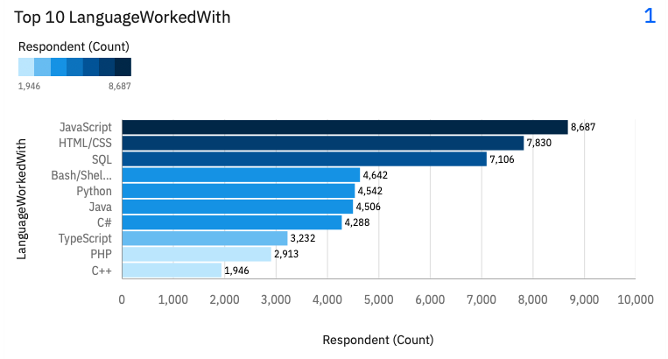
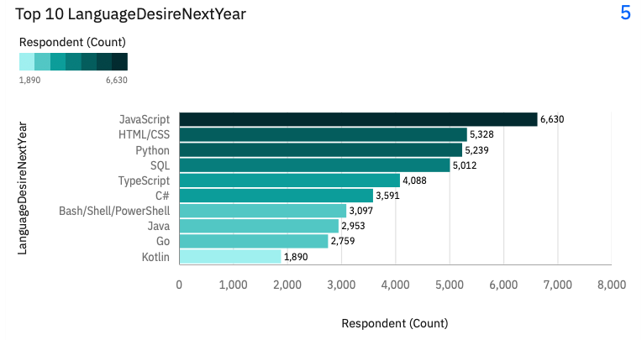
PROGRAMMING LANGUAGE TRENDS
Current Year
Next Year

Slide 8
PROGRAMMING LANGUAGE TRENDS - FINDINGS & IMPLICATIONS
Findings
The top two, JavaScript and HTML/CSS, keep it in place.
Python is growing rapidly and is in third place.
PHP will no longer be in the top 10.
Implications
Demand for Python has increased as data utilization has become commonplace in the business domain.
The proliferation of the Node.js platform has reduced the demand for PHP, as JavaScript can now be used on the server side.

Slide 9
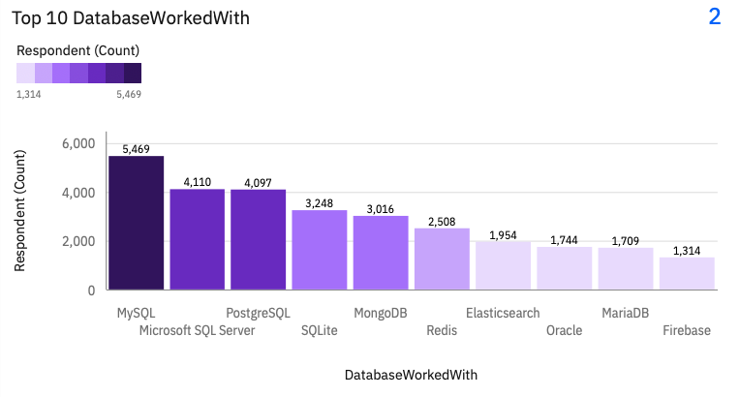
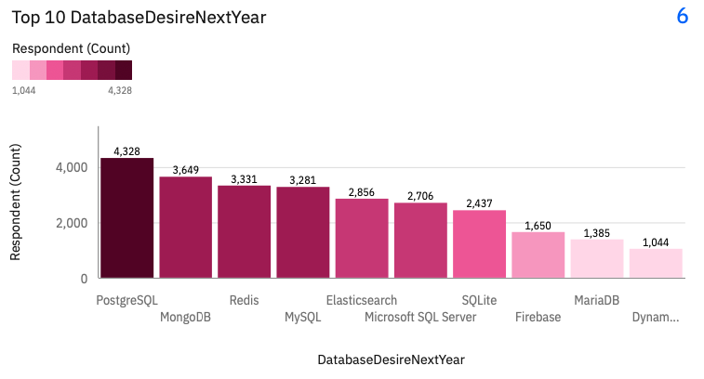
DATABASE TRENDS
Current Year
Next Year

Slide 10
DATABASE TRENDS - FINDINGS & IMPLICATIONS
Findings
PostgreSQL, MongoDB, and Redis have grown to become the Top 3.
MySQL's ranking is dropping, but demand is still there.
Firebase is also growing.
Implications
PostgreSQL is growing in popularity due to its scalability, ease of querying, and support for many different types of data.
Firebase is considered to be growing because it does not require back-end processing.

Slide 11
DASHBOARD
https://github.com/Rion-Sato/Peer_Graded_Assignment_Dashboards/blob/main/Peer-Graded%20Assignment.pdf
Note: This is a GitHub link that includes a PDF of the Dashbord I created with Cognos Analytics due to an issue with IBM Cloud not being available. Please grade the application based on this PDF. I have read officially on the discussion forum that there is no point deduction for using this method.

Slide 12
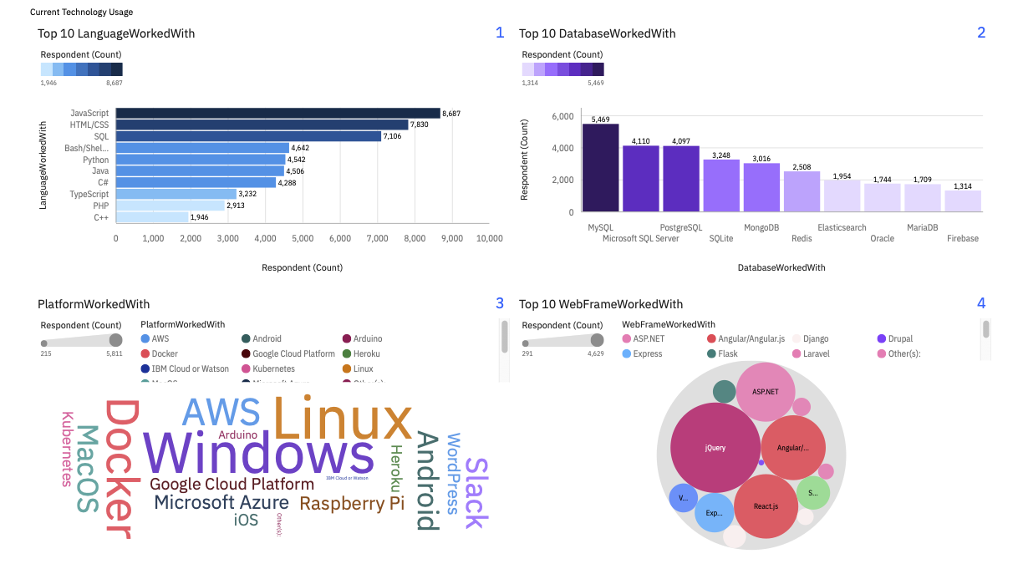
DASHBOARD TAB 1

Slide 13
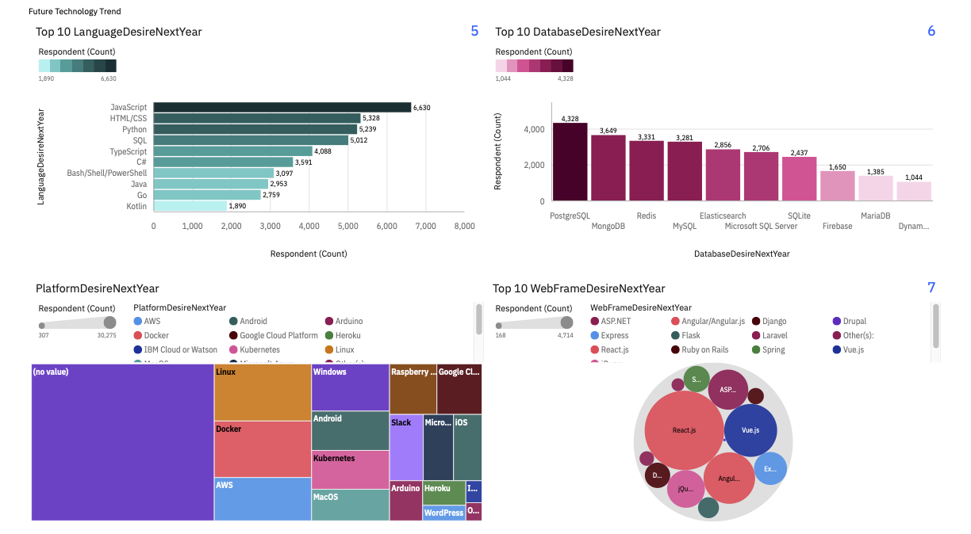
DASHBOARD TAB 2

Slide 14
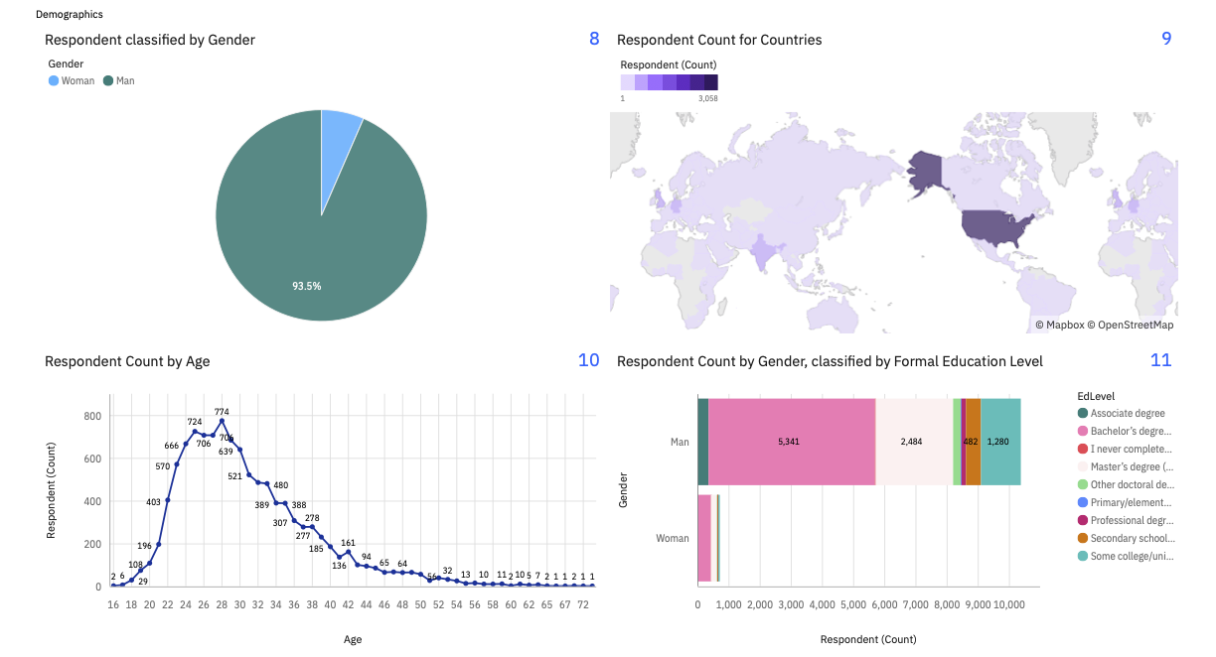
DASHBOARD TAB 3

Slide 15
DISCUSSION

Slide 16
OVERALL FINDINGS & IMPLICATIONS
Findings
JavaScript widely used and HTML/CSS getting popular.
Over 90% young male developers.
Developers mostly located in developed countries.
Implications
JavaScript and HTML/CSS web frames gaining followers.
Global polarization of developers location and gender.
Young developers without postgrad studies on its majority.

Slide 17

CONCLUSION
Developers are people with very marked characteristics.
A good idea of popularity trends of different tools, platforms and languages can be obtained.
There is a job to be done to spread accessibility of this labor market to countries in development.

Slide 18

APPENDIX

Slide 19
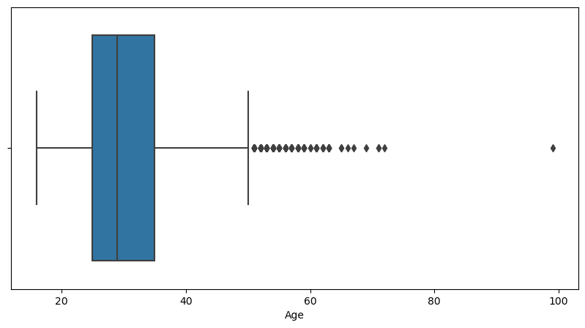
AGE DISTRIBUTION BOXPLOT

Slide 20
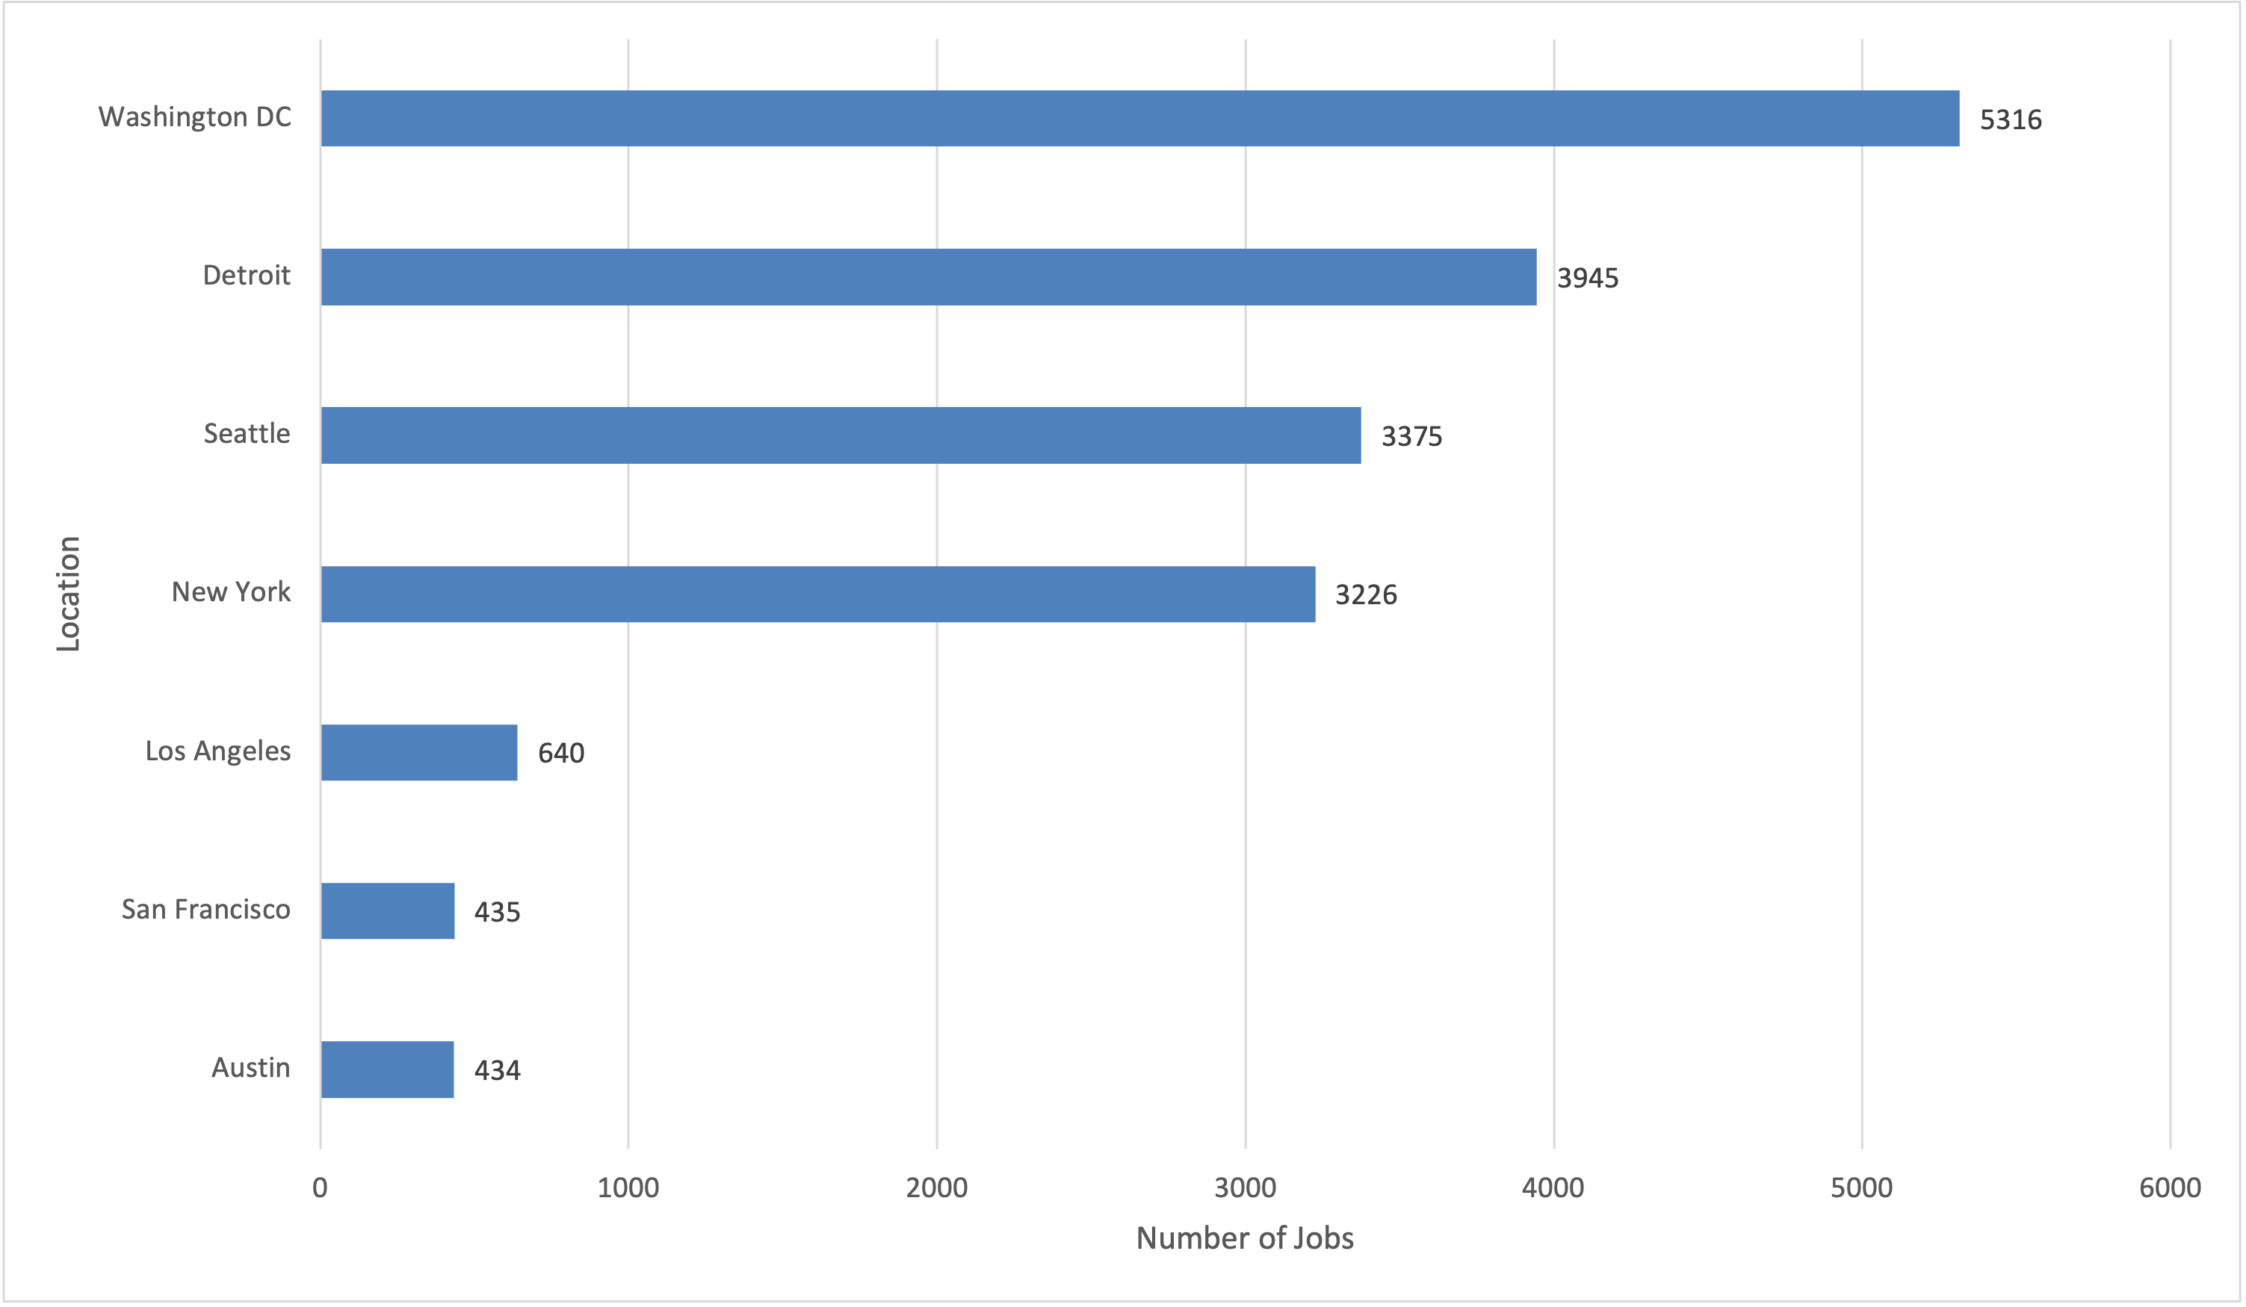
JOB POSTINGS

Slide 21
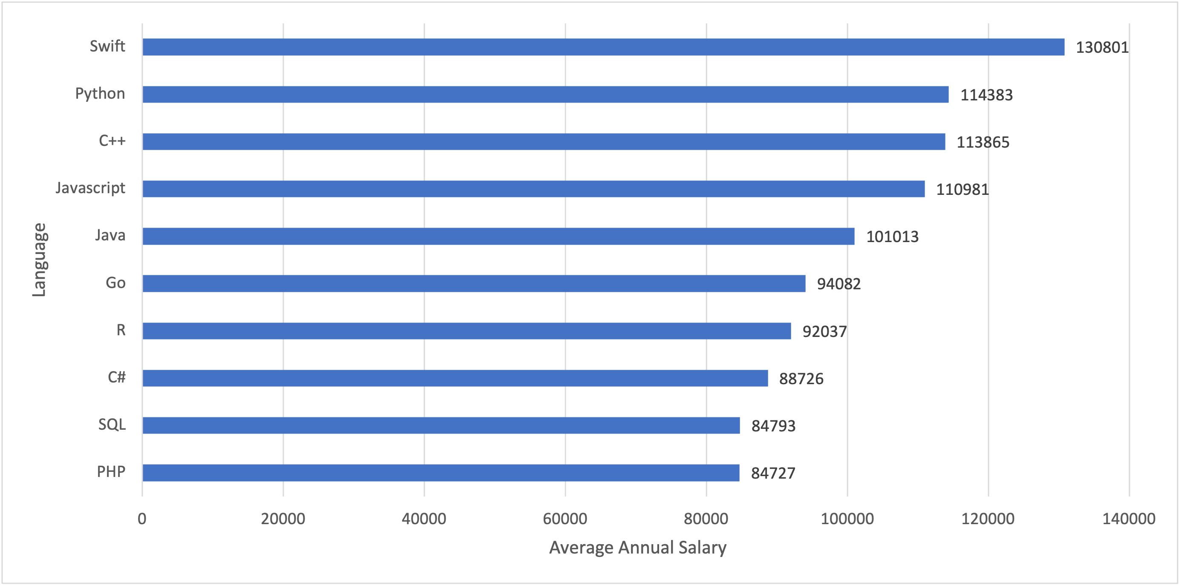
POPULAR LANGUAGES

